Slide 1
NAIVE BAYES CLASSIFIER
BY
Anusha g s

Slide 2
CONTENTS
Introduction to Stroke Prediction
Naïve Bayes Classifier
Problem Statement
About Dataset
Data Collection and Pre-processing
Model Building
Hyperparameter Tuning
Performance Metrics

Slide 3
Introduction to Stroke Prediction
Stroke is a blood clot or bleeds in the brain, which can make permanent damage that has an effect on mobility, cognition, sight or communication.
Stroke is the second leading cause of death worldwide and one of the most life- threatening diseases for persons above 65 years.
Prevention of stroke - More than 70% of strokes are first events, thus making primary stroke prevention a particularly important aspect.
The cost of stroke for the year 2002 was estimated to be as high as $49.4 billion in the United States of America (USA), while costs after discharge were estimated to amount to 2.9 billion Euros in France.

Slide 4
What is Naive Bayes
Naive Bayes Classifier is one of the simple and most effective Classification algorithms which helps in building the fast machine learning models that can make quick predictions.
It is a probabilistic classifier, which means it predicts on the basis of the probability of an object.
It is mainly used in text classification that includes a high-dimensional training dataset.

Slide 5
Problem Statement
This dataset is used to predict whether a patient is likely to get stroke based on the input parameters like gender, age, various diseases, and smoking status.
Each row in the data provides relevant information about the patient.

Slide 6
About Dataset
The dataset Used in this project is Health Care Stroke Prediction dataset.
The dataset Contains 5110 datapoints.
There are 12 features in the dataset , in this we have 5 categorical features and 6 are the Numerical features.
The remaining one i.e., the target variable is Stroke.
The total number of value counts of 1 and 0 in the target variable are 249 and 4861.
In the train_test_split , the total number of Train datapoints are 4088 and Test datapoints are 1022.

Slide 7
Data Collection and Pre-processing
First, we read the dataset and display the starting five rows of the dataset.
We will be checking for Categorical and Numerical features, datatypes of the datasets.
Separating the Numerical and Categorical features.
Handling the missing values and outliers.
Converting the categorical variables to numerical using get_dummies() method.
The dataset also contains some continuous variables, this can be done by scaling method.

Slide 8
Model Building
In the model building, we firstly create the class for naïve bayes classifier.
According to the naïve bayes working we need to initiate the function, fit and predict.
For the building naïve bayes classifier , compute mean , variance and prior probability for each class.
Calculate the Conditional or Likelihood Probability and Posterior Probability.
Fit the model and predict the accuracy.

Slide 9
Hyperparameter Tuning
There are two methods for Hyperparameter tuning.
GridSearchCV
RandomizedSearchCV
Before these methods we compute Cross Validation.
In the Cross Validation we specify the k value.
Cross Validation refers to statistical method of evaluating and comparing learning algorithms by dividing data into two segments.
There are Different types of Cross Validation. They are K-fold cross-validation and Stratified k-fold cross-validation.

Slide 10
Performance Metrics
There are several different types of performance metrics are present.
Confusion Matrix, Precision, Recall and F1 score.
Confusion Matrix presents a table layout of the different outcomes of the prediction and results of a classification problem and helps visualize its outcomes.
Precision defines as follows i.e. , True Positive/(True Positive +False Positive).
Recall , also known as the true positive rate (TPR).
Formula for Recall is True Positive/(True Positive + False Negative).
F1 Score defines as a machine learning evaluation metric that measures a model's accuracy.
It combines the precision and recall scores of a model.
Formula = 2*Precision*Recall/Precision + Recall.

Slide 11
CODING FOR STROKE PREDICTION

Slide 12
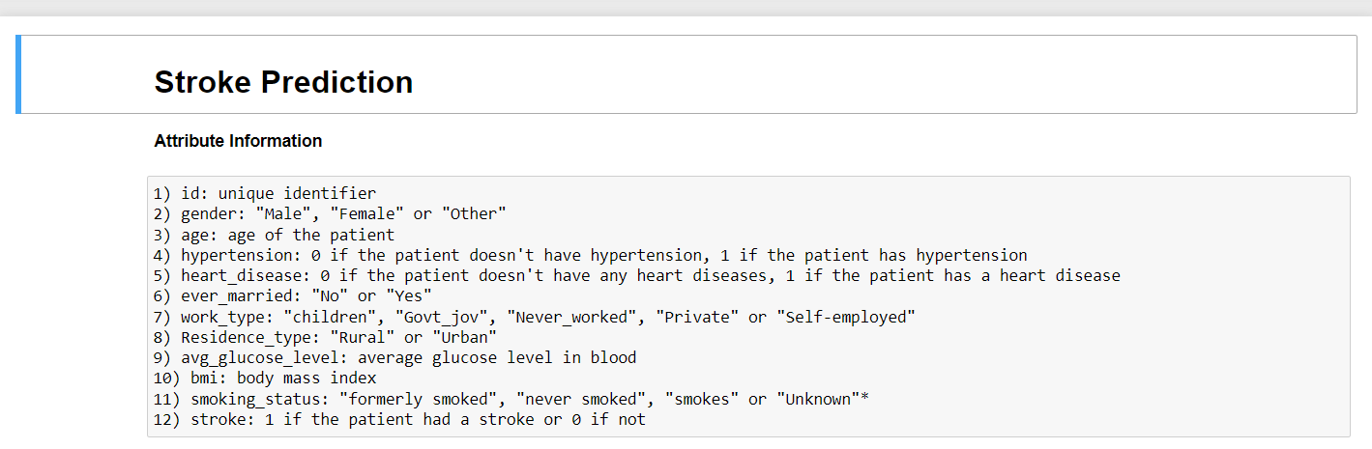
Attributes lists

Slide 13
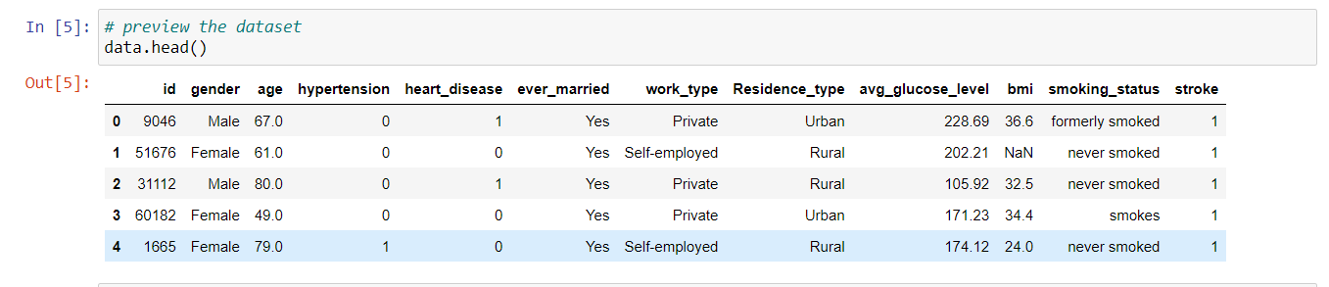
Dataset Used

Slide 14
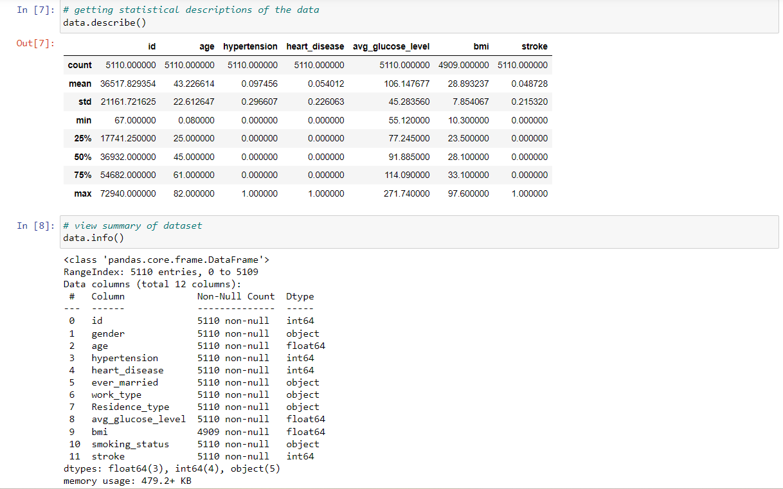
Getting Statistical and Summary of the dataset.

Slide 15
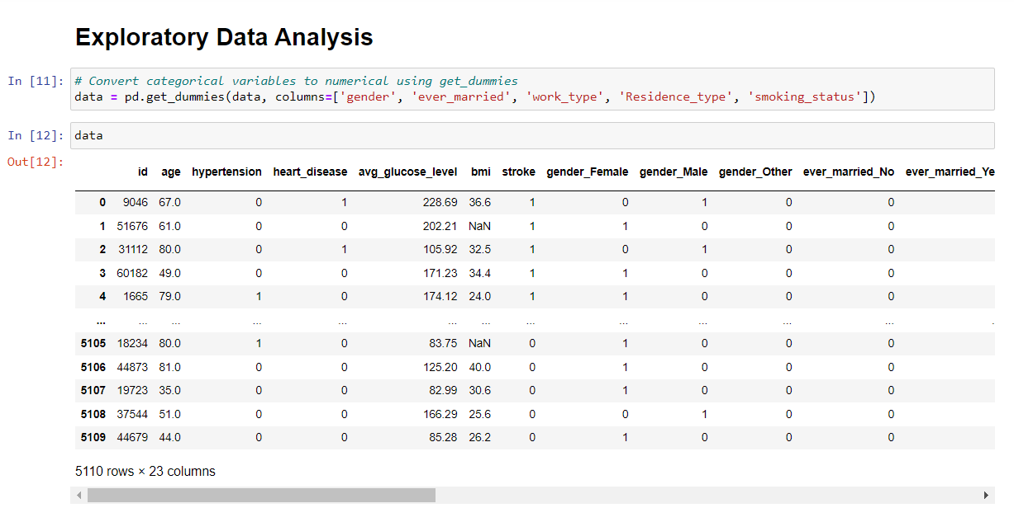
Converting Categorical variables to Numerical Using get_dummies().

Slide 16
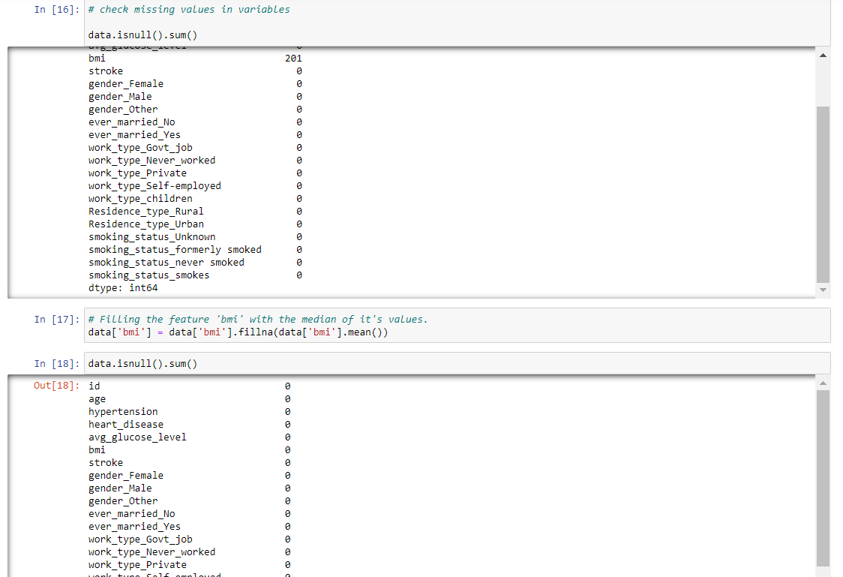
Checking Null Values, i.e., bmi has 201 null values. The null values are replaced by the mean values.

Slide 17
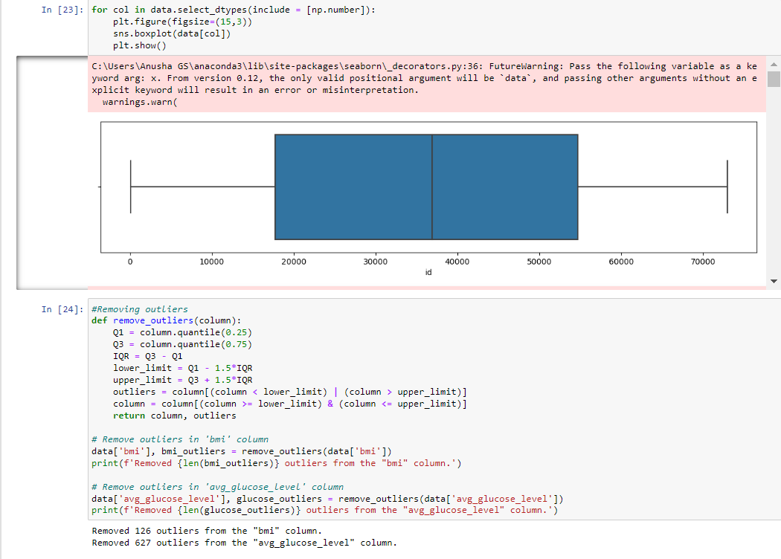
Checking for outliers of the Numerical Feature and Removing outliers.

Slide 18
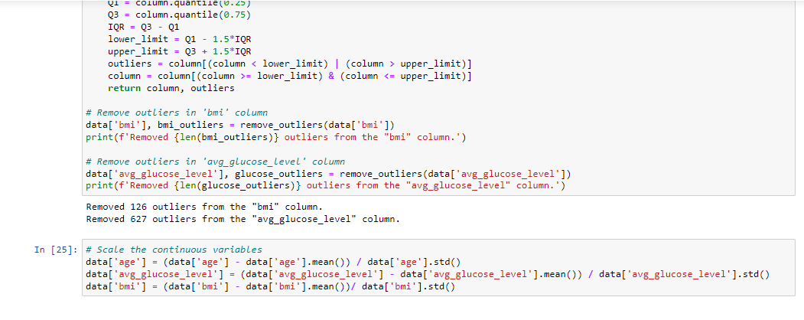
Scaling the Continuous Variables

Slide 19
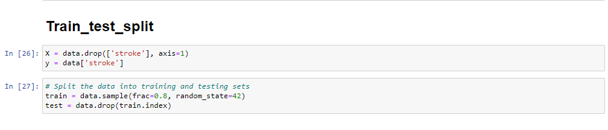
Train Test Splitting of the dataset.

Slide 20
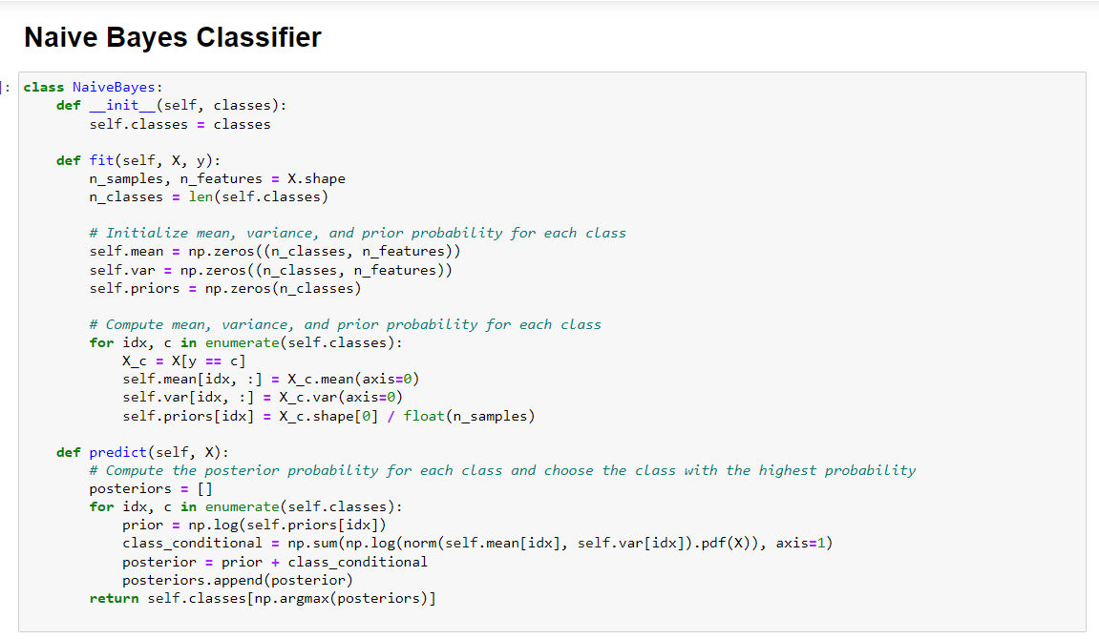
Naïve Bayes Classifier Model

Slide 21
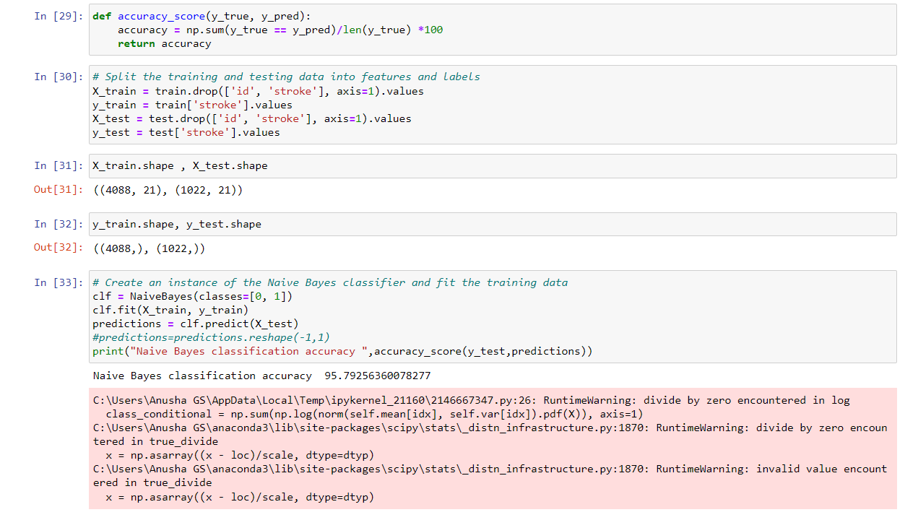
By fitting the model and Checking the accuracy of the model

Slide 22
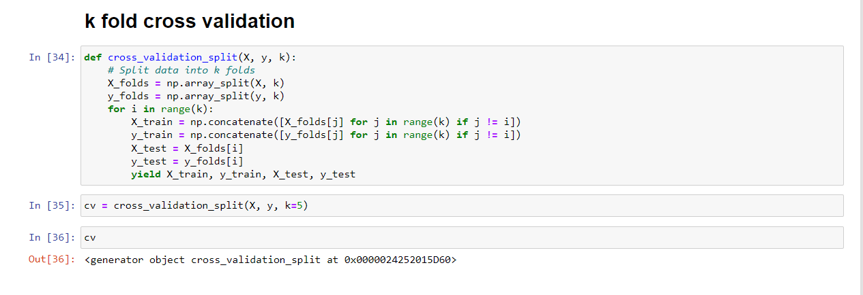
K fold Cross Validation

Slide 23
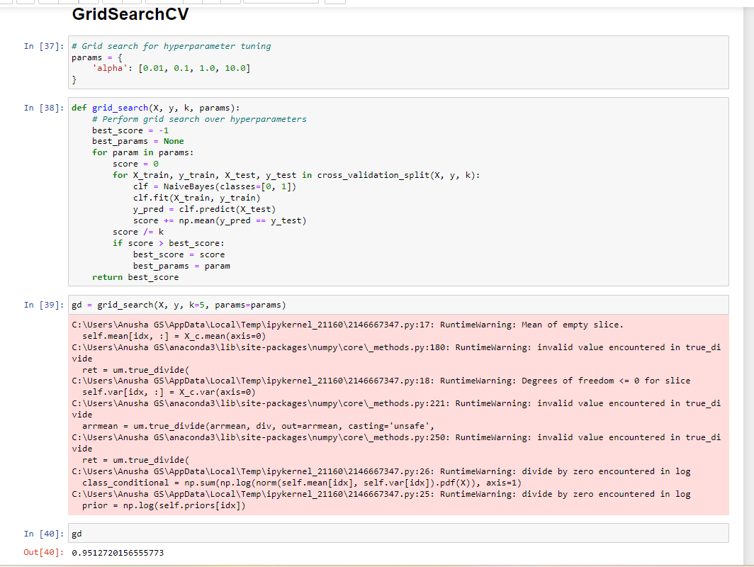
Hyperparameter Tuning using GridSearchCV

